Slide 1

RAJIV GANDHI PROUDYOGIKI VISHWAVIDYALAYA BHOPAL (M.P)
presentation
on
Weather forecasting app
By
Shahid afridi(
CSE(6th sem)

Slide 2
CONTENTS
Introduction
Uses of the application
How the application has created
HTML
CSS
JavaScript
Link of the project
Conclusion

Slide 3
INTRODUCTION
The Weather forecasting App is a project that focuses on simple weather forecasting.
The user can examine the current state of the climate probability and forecast whether the day will be sunny or cloudy.
In the software, the user can write down the name of any city in the world.

Slide 4
USES OF THE APP
To plan Journey ahead.
It helps to know more details about the weather such as visibility, chances of rainfall, humidity etc.
Useful For Various Weather Operations

Slide 5
HOW DID I CREATE THE APPLICATION
The HTML, CSS and JavaScript has used to create the app.
I have fetched API from OpenWeatherMap.
We'll be building a geolocation-based weather app that will show us the current weather data depending on the user's location.

Slide 6
HTML
HTML stand for Hyper Text Markup Language.
HTML consists of a series of elements.
The structure of the Web page has been described using HTML.
Every thing which we see on the web page is added with the help of HTML.
HTML elements tell the browser how to display the content.

Slide 7
CSS
CSS stands for Cascading Style Sheets
How HTML elements are to be displayed on screen, paper, or in other media has described using CSS.
The layout, colors, font size etc. are controlled by using CSS.

Slide 8
JAVASCRIPT
JavaScript is the programming language of the Web.
JavaScript is a text-based programming language used both on the client-side and server-side that allows you to make web pages interactive.
It has been used for fetch API, for call and get data from a third-party service.

Slide 9
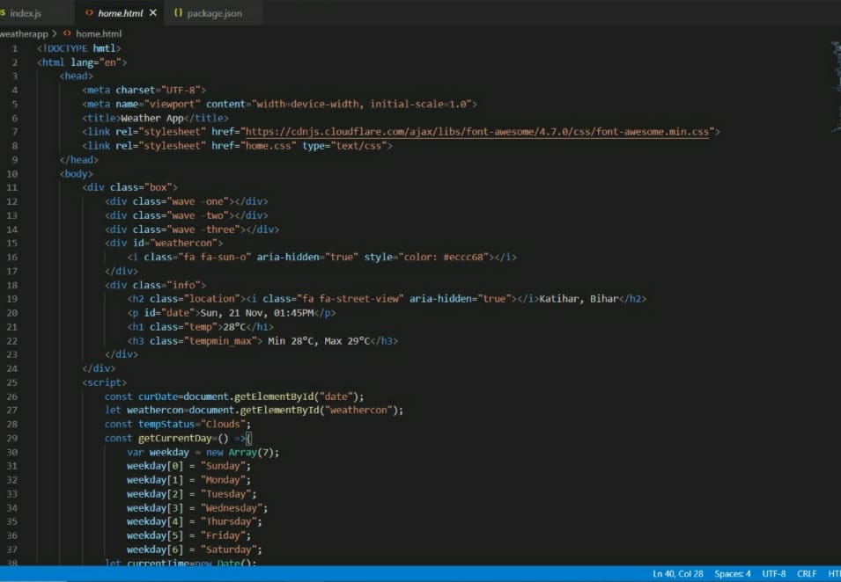
Here’s some screen shots of the code and output
Fig. no. - 1

Slide 10
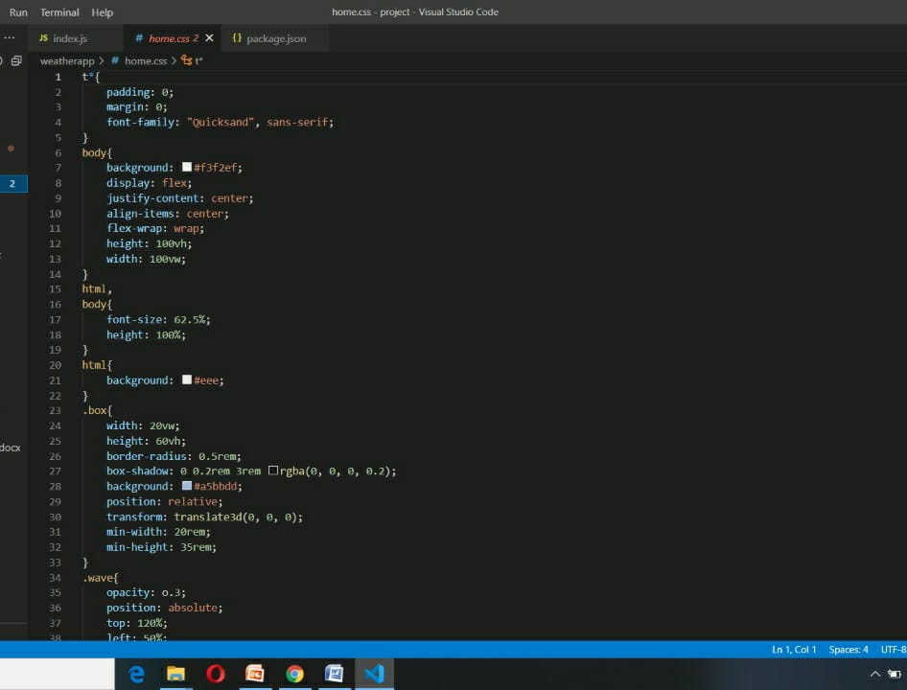
Fig. no. - 2

Slide 11
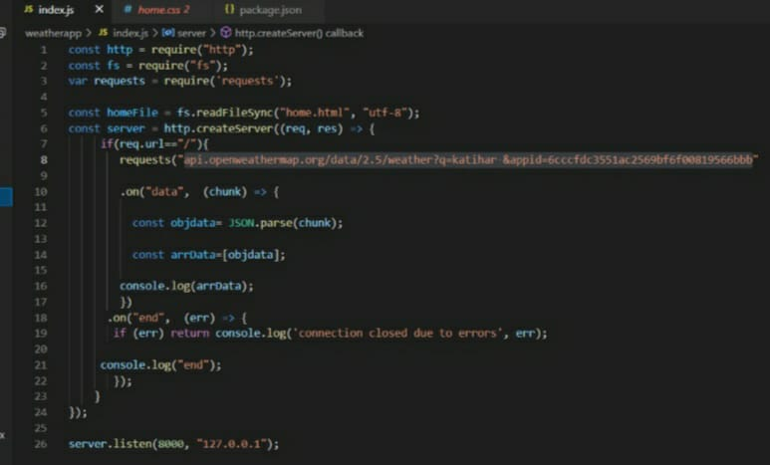
Fig. no - 3

Slide 12
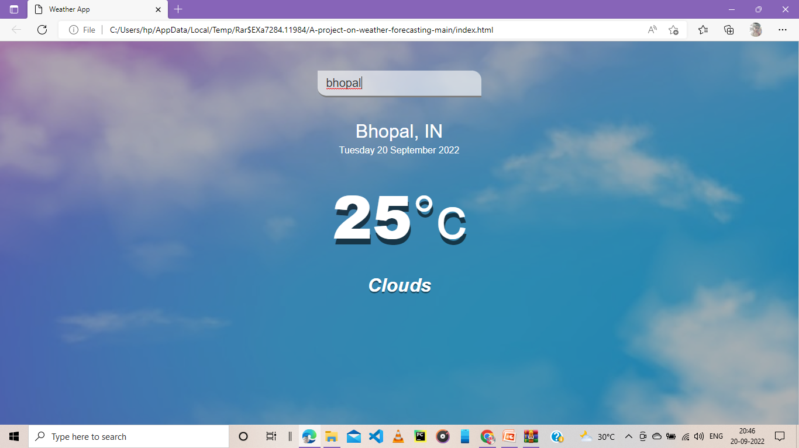
Fig. no.- 4

Slide 13
Here’s the link of the web application
https://github.com/sahidafridi04/A-project-on
weather-forecasting.git

Slide 14
CONCLUSION
The Design and Development of this Application will significantly enhance the nature of Farming and Agriculture.
This application is Economically, Technically and Operationally Feasible.
It is User Friendly, so that every user can handle it with ease.
This application is developed such that it will not use much of phone RAM and memory space.
This Application provides detail information with the use of Interactive images.

Slide 15
REFERENCES
https://www.w3schools.com [ last accessed date-24/108/2022]
https://www.slideshare.net [ last accessed date-05/09/2022]
https://www.rapidapi.com/openweathermap/api
[ last accessed date-12/09/2022]

Slide 16
THANK YOU.

